Slide 1
📊 PhonePe Pulse – Transaction Insights Dashboard
Name: Muthuramakrishnan R
Batch: DS-S-WD-T-B71

Slide 2



❓ Problem Statement
🔍 Understand PhonePe’s transaction ecosystem across India
🌍 Analyze regional usage & growth patterns
🛡 Study user behavior & insurance adoption

Slide 3
📖 Project Overview
01
💡 PhonePe is India’s leading digital payments platform.
02
This project builds an interactive dashboard to visualize transaction data.
03
Focus Areas:
📈 Transactions
👥 Users
🛡 Insurance
📍 Regions

Slide 4

🎯 Objectives
📊 Analyze state & district-wise transactions
👥 Study user registrations and app engagement
🛡 Evaluate insurance penetration & adoption trends
🏆 Identify top-performing states/districts

Slide 5
🛠 Tools & Technologies
🐍 Python – Data Processing
💾 MySQL – Database
🌐 Streamlit – Web Dashboard
01
02
03
📊 Plotly – Visualizations
📁 GitHub – Version Control
04
05

Slide 6
💡 Key Insights
📈 Merchant payments dominate transactions
📱 Xiaomi, Samsung, Vivo lead in device usage
01
02
🛡 Insurance transactions show consistent growth
🌍 Maharashtra & Telangana are top-performing states
03
04

Slide 7
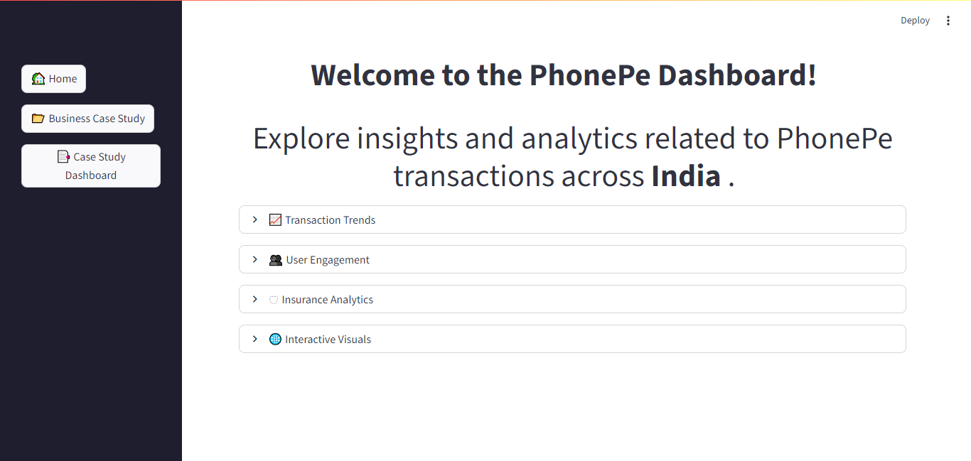
🖥 Dashboard Snapshots

Slide 8
🏢 Business Use Cases
📊 Transaction dynamics for fintech strategies
🌍 Identify market expansion opportunities
👥 User engagement insights for product targeting
01
02
03
🛡 Insurance growth analysis for policy design
📊 User Engagement Shifts
04
05

Slide 9
✅ Conclusion
01
⚡ Real-time insights through interactive dashboards
02
📈 Scalable and adaptable for future metrics
03
🤝 Usability for businesses, analysts, and policymakers

Slide 10
🙏 Thank You!
✨ PhonePe Transaction Insights Dashboard ✨
Presented by: Muthuramakrishnan

